Slide 1
DAT Class 13
Cross Validation, Regularization

Slide 2
Cross Validation
Machine Learning With Python

Slide 3
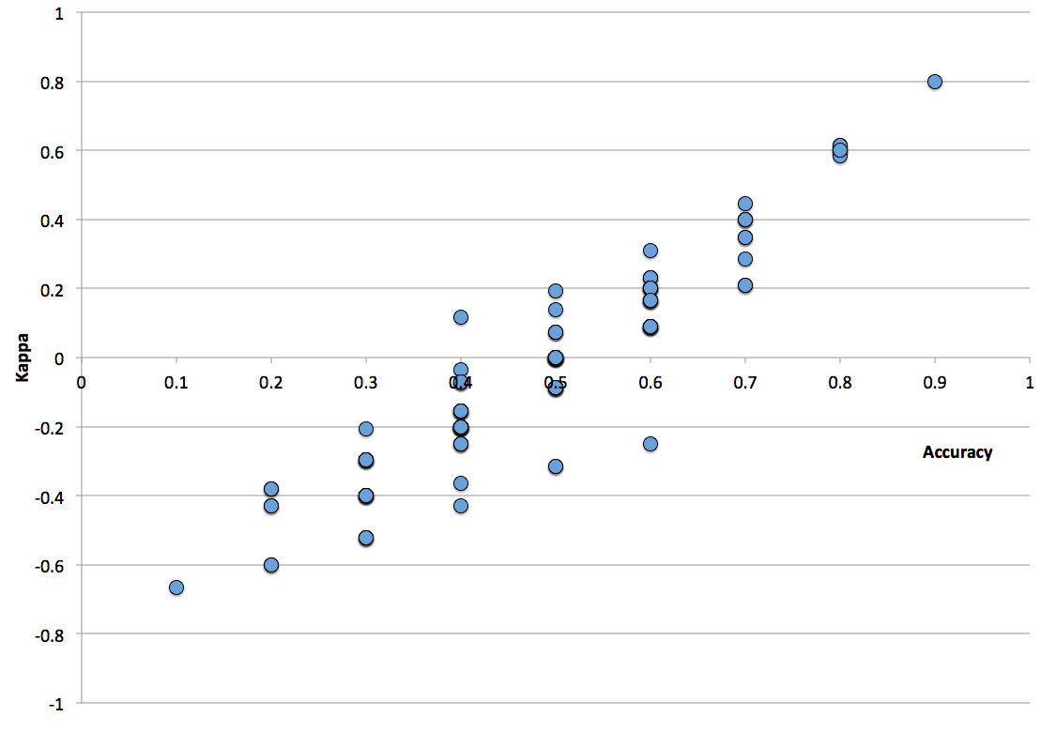
Cross Validation
Basic idea is simple:
Separate your data into two groups, a “test” set and a “training” set
Test set is not touched until the very end, and is only used for final model evaluation
Training set is used for fine-tuning and evaluating your model
Notes:
This is where you go and introduce the training and test split. Go through the shapes of the returned values, make sure everyone is clear on what’s happening.
For

Slide 4
Cross Validation
Additional step is to add a validation set:
Test-set within the test-set
Used to compare results when doing cross validation
Meant to be a portion of your training set that resembles the test set
Notes:
This is where you go and introduce the training and test split. Go through the shapes of the returned values, make sure everyone is clear on what’s happening.
For

Slide 5
How Do We Know How Our Model Performs Under
A Variety of Conditions?

Slide 6
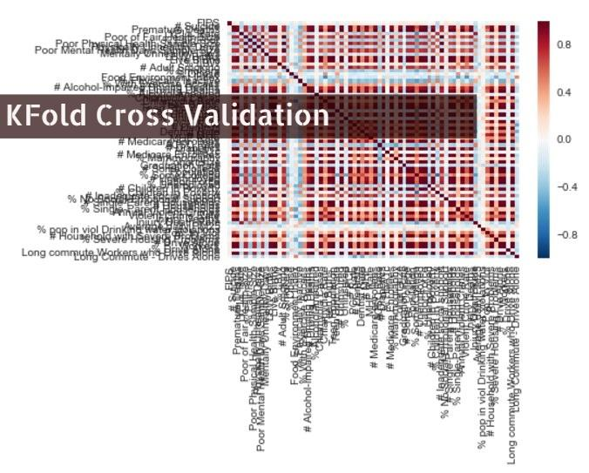
Notes:
This is where you go and introduce the training and test split. Go through the shapes of the returned values, make sure everyone is clear on what’s happening.
For

Slide 7
Cross Validation
Kfold Cross Validation:
More thorough way of cross validation
Split training set into K different groups
For k rounds, train your data on K-1 groups, and score it on the one remaining set
Is only used on the training set
Notes:
This is where you go and introduce the training and test split. Go through the shapes of the returned values, make sure everyone is clear on what’s happening.
For

Slide 8
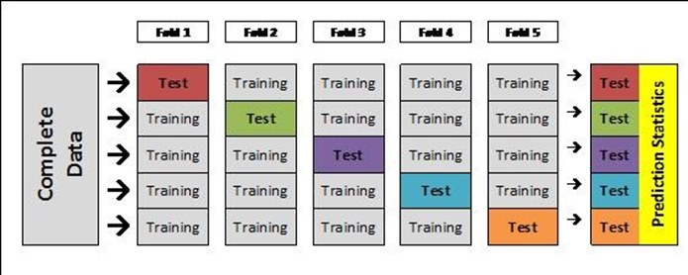
Notes:
After this slide, introduce cross_val_score and how to implement it

Slide 9
KFold
Key ideas:
Every row in the training set is used for both training and validation
But never at the same time
Different validation scores gives you an ability to see how model performs under different circumstances
Notes:
This is where you go and introduce the training and test split. Go through the shapes of the returned values, make sure everyone is clear on what’s happening.
For

Slide 10
Cross Validation
Key idea about cross validation:
Allows you to compare changes between models
Ie, your cross validated score gives you a benchmark to use to determine whether or not you’re making progress or not
Notes:
This is where you go and introduce the training and test split. Go through the shapes of the returned values, make sure everyone is clear on what’s happening.
For

Slide 11
The Story So Far…..
Linear models: extended version of y = mx + b
Standardization: necessary step to interpret model correctly
Cross Validation:
Splitting up data set into training, validation, and test sets
Train and tune on training and validation sets, score on test
KFold: most common technique
Basic Process:
Standardize data
Split into training/test
Compare different versions of model through cross validation
Take best version, fit on the entire training set
Notes:
After this, re-fit on the entire training set, and then score your final model.

Slide 12
Cross Validation
Concept check:
What would be the expected behavior from increasing the number of folds?
When would a larger number of folds make sense?

Slide 13
Regularization
Machine Learning With Python

Slide 14
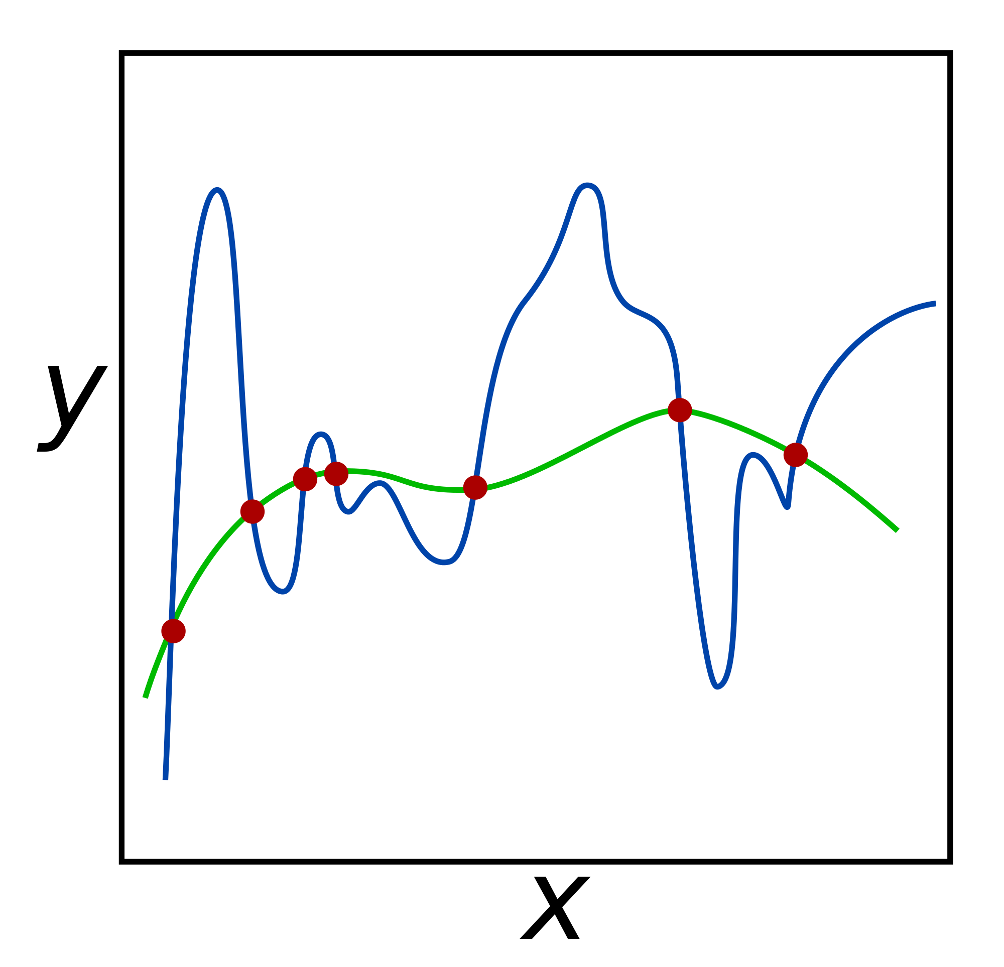
Regularization
Commonly used technique to curb overfitting in your models.
Does so by deliberately injecting a measured amount of bias into your model
You call bias injection a ‘penalty’
Result is that it shrinks your weights
Also known as ‘weight’ decay
Used in most algorithms that use gradient descent for optimization
Notes:
This is where you go and introduce the training and test split. Go through the shapes of the returned values, make sure everyone is clear on what’s happening.
For

Slide 15
Regularization
The regularization parameter:
Has different names:
Alpha
Lambda
C
Determines the strength of your regularization
Common parameter to test in cross validation

Slide 16
Regularization
Regression with an L2 penalty is called Ridge Regression
Regression with an L1 penalty is called Lasso Regression
Regularization is used on a lot of ML algorithms - basic concepts are the same throughout
Always a good idea to regularize - to not do it is usually a mistake

Slide 17
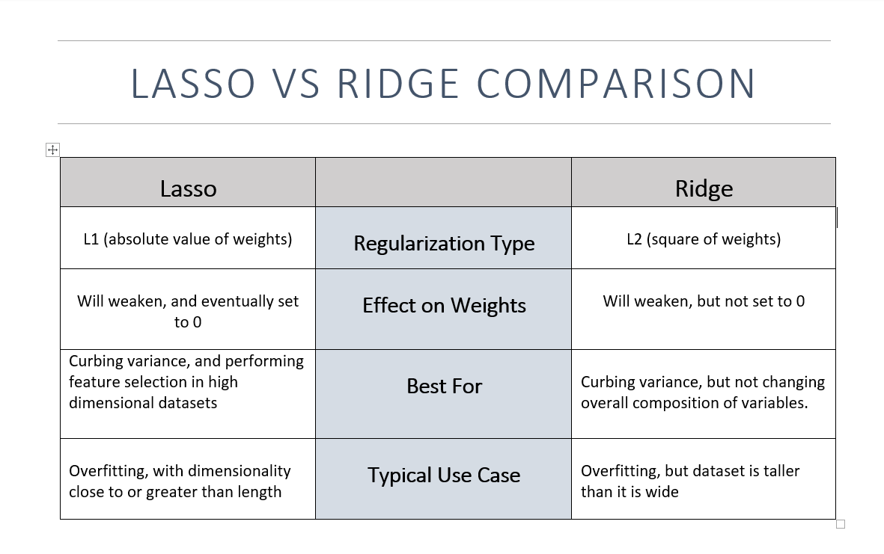
Notes:
After this slide, introduce Ridge Regression, point out alpha as a parameter, and make the chart -- decide for yourself if it’s a good idea to do it by hand or not.

Slide 18
Pipelines

Slide 19
Observation: Data Handling And Prep Is A Pain

Slide 20
Transformer API: Second Part of Scikit Learn
Allows You To Automate Many Data Processing Steps

Slide 21
Major Function Calls
Fit: Stores values in dataset necessary to do transformation
Transform: Processes dataset in appropriate way
Fit_transform: Does both steps in one swoop
Inverse_transform: Restores dataset back to its original form

Slide 22
Key Benefits
Allows you to separate concerns with training and test set processing more easily
Multiple transformers can be chained together using pipelines
You can incorporate external libraries into pipelines to give yourself a variety of options for processing data
Pipelines can include estimators, to give yourself a succinct, end-to-end solution for processing data

Slide 23
Case In Point: Category Encoders Library

Slide 24
Category Encoders
Under appreciated library of the python ecosystem
Easiest way to encode categorical columns on training and test set
Is designed to take pandas df’s in, and put out pandas df’s -- unlike scikit learn
Contains a number of useful ways to encode categorical columns beyond ordinal & onehot -- useful for when you have columns with high amounts of unique values

